Slide 1
GLOBAL ECONOMIC & DEMOGRAPHIC TREND ANALYSIS (1960–2016) Using Power BI & DAX
Prepared by: Kamatchi Lalitha.R
Course & Batch: DA & DS(June25)
Date: 12-01-2026

Slide 2
Project Objective
Analyze global population and economic trends (1960–2016)
Identify regional growth patterns and inequalities
Apply DAX measures and statistical analysis
Present insights using interactive Power BI dashboards

Slide 3
Dataset Overview
Total Countries: 224
Total Population: ~6 Billion
Time Period: 1960–2016
Dimensions: Country, Region, Year
Measures: Population, GDP, Literacy, Birth Rate, Death Rate
Average GDP per Capita: 9.7K
Average Literacy Rate: 52%Average Birth Rate: 13.03
Average Death Rate: 29.09
Infant Mortality Mean: 13,501

Slide 4
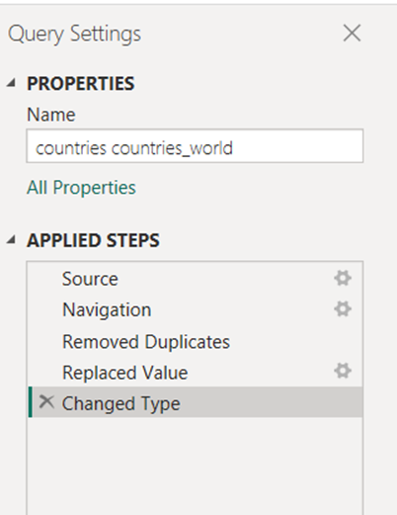
Data Cleaning & Data Processing
Data Cleaning Steps
Removed duplicate records
Handled missing text values by replacing with "Unknown“
Standardized country, region, and income group names
Ensured Year column was in correct data type
Checked for outliers in population and GDP values

Slide 5
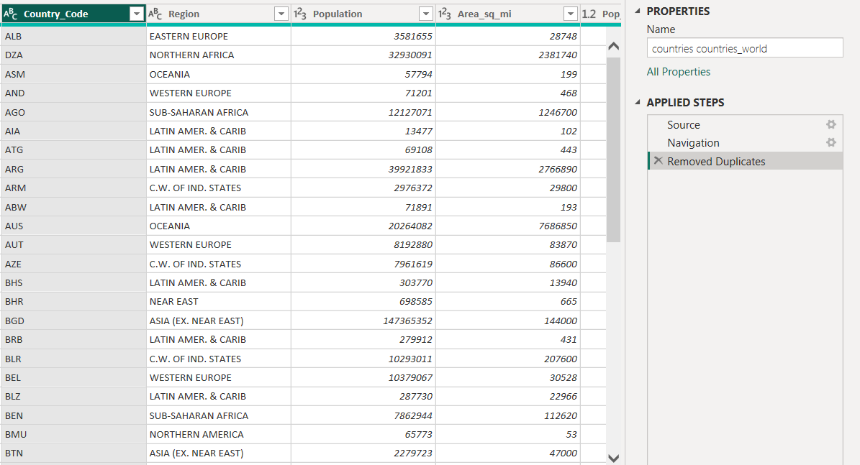
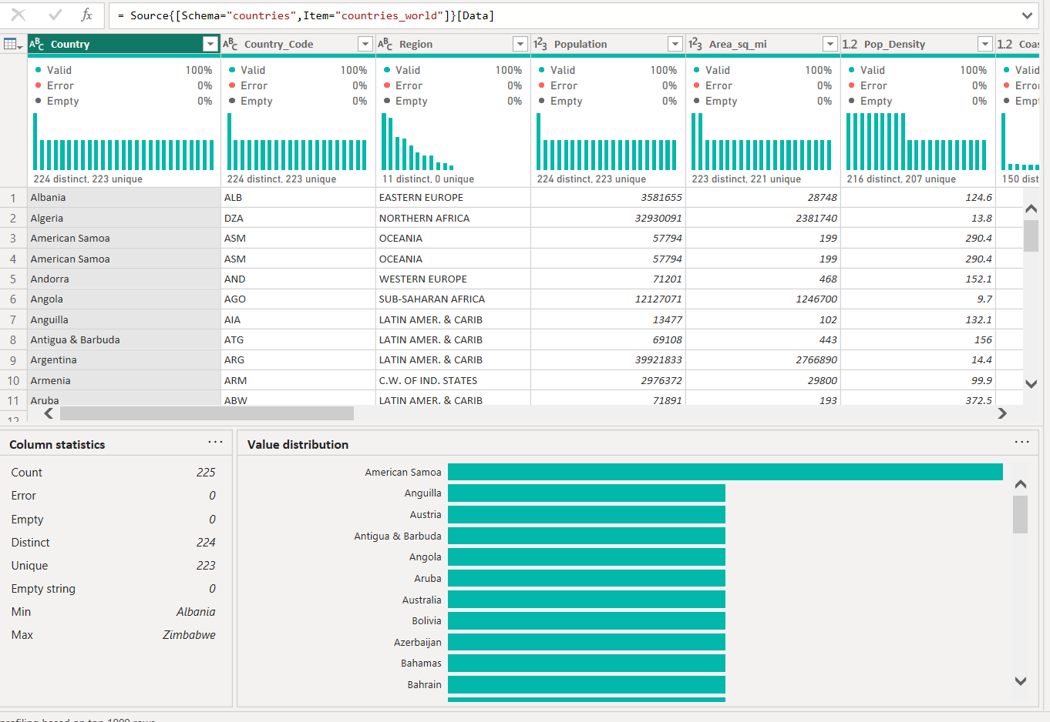
Removed Duplicates & Nulls, Standardized Formatting

Slide 6
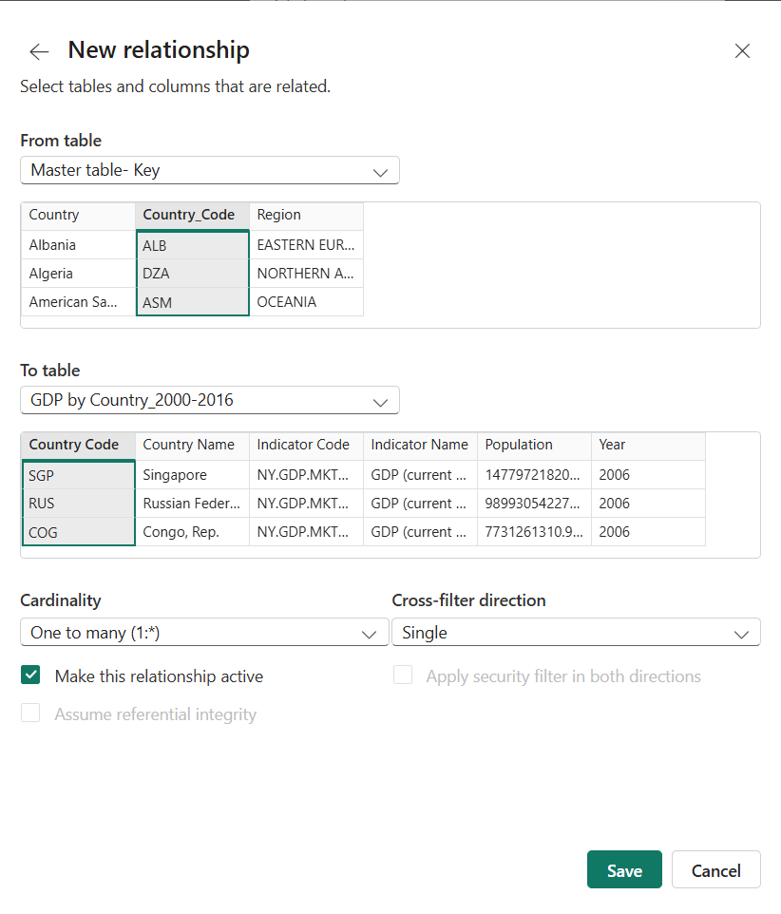
Data Processing Steps
Create relationships between tables (Country _ Year)
Converted raw indicators into calculated measures
Aggregated data by Region and Year
Optimized data model for better performance
Result: Clean, reliable dataset ready for DAX calculations

Slide 7
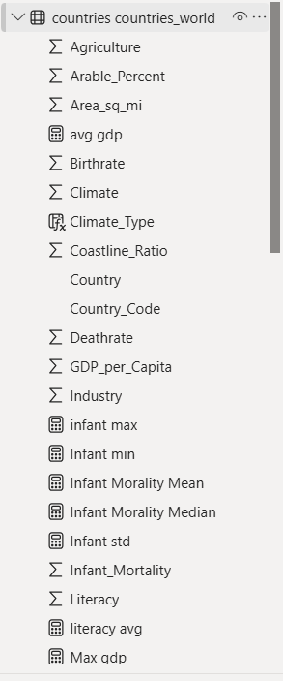
KPI
Average GDP per Capita: 9.7K
Average Literacy Rate: 52%
Average Birth Rate: 13.03
Average Death Rate: 29.09
Infant Mortality Mean: 13,501

Slide 8
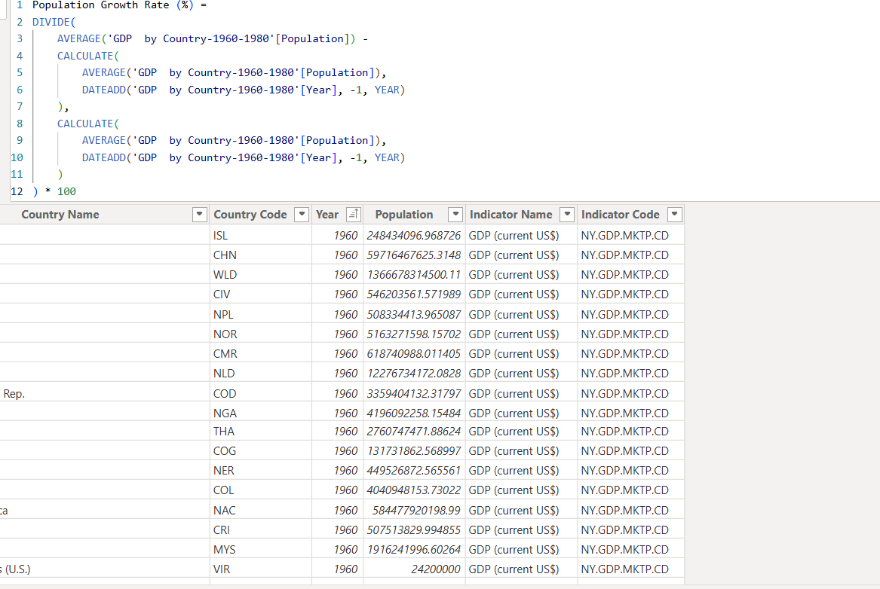
DAX CALCULATIONS
DAX – Average Population
Purpose
To calculate overall average population across years.
DAX Formula
Avg Population = AVERAGE('GDP by Country'[Population])
Insight
Shows baseline population level
Used in KPI cards and trend visuals
Insight
Identifies rapid growth and decline years
Useful for demographic trend analysis

Slide 9
DAX FORMULAS USED
GDP per Capita = DIVIDE(Avg Population by Region =
CALCULATE(
AVERAGE('GDP by Country'[Population]),
ALLEXCEPT('GDP by Country', 'GDP by Country'[Region])
)
SUM('GDP by Country'[GDP]),
SUM('GDP by Country'[Population])
)
Avg GDP per Capita =
AVERAGE('GDP by Country'[GDP per Capita])
Infant Mortality Mean =
AVERAGE('GDP by Country'[Infant Mortality])

Slide 10
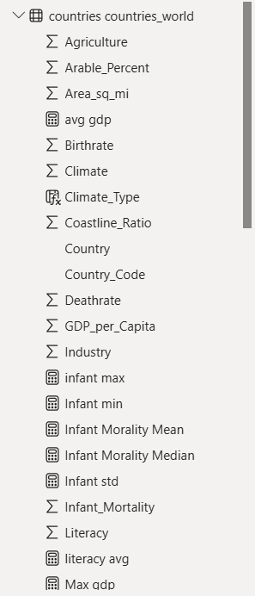
Statistical Analysis Applied
Mean
Year-over-Year Growth
Trend Analysis
Regional Aggregation
Comparative Analysis
All statistics computed using DAX measures

Slide 11
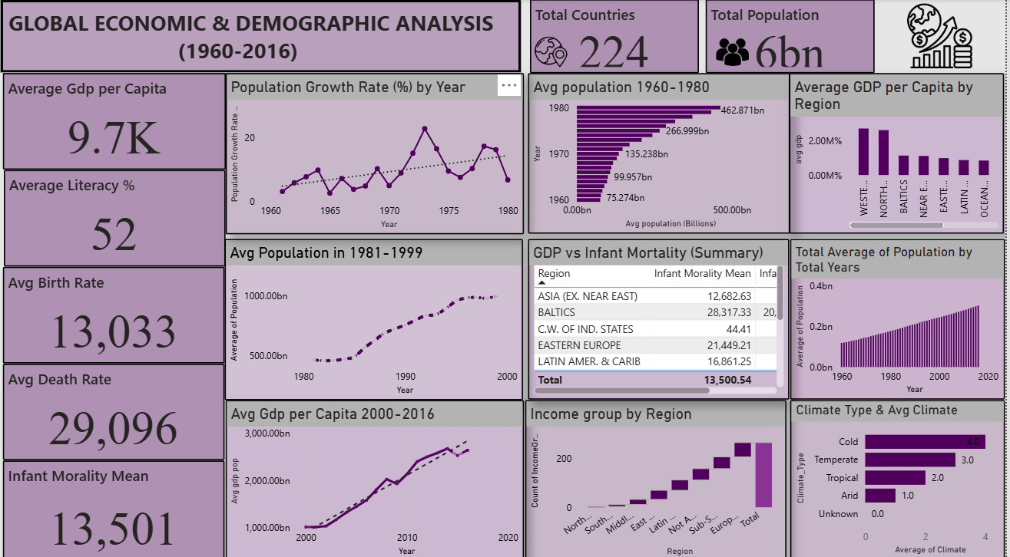
WORLD GDP ANALYSIS DASHBOARD

Slide 12
DASHBOARD OVERVIEW
This Power BI dashboard presents a consolidated view of global population, health, and economic indicators across multiple decades.
The dashboard integrates key metrics such as population growth, birth and death rates, infant mortality, GDP, and income groups.
It enables trend analysis, regional comparison, and correlation analysis to support data-driven insights.
The dashboard is designed using a 16:9 layout (1280 × 720 px) for optimal readability and professional presentation.

Slide 13
Key Performance Indicators (KPIs)
Average Birth Rate (per 1,000 population): Indicates population growth intensity.
Average Death Rate (per 1,000 population): Reflects overall mortality conditions.
Infant Mortality Rate (per 1,000 live births): Measures healthcare quality and child survival.
Average Population per Country: Shows the overall population scale across countries.
These KPIs provide a quick high-level snapshot of global demographic and health conditions.

Slide 14
Population Growth Trend Analysis
The line chart displays year-over-year population growth rate (%).
Highlights periods of accelerated and slowed growth over time.
Helps understand demographic transitions across decades.
Growth variations are influenced by changes in birth and death rates.

Slide 15
Population Trend Over Time
Bar chart (1960–1980) compares average population levels across years.
Line chart (1981–1999) shows long-term population growth trend.
The analysis indicates a steady and continuous increase in global population.
Significant acceleration is observed after the 1980s.

Slide 16
GDP per Capita Growth Analysis
Line chart illustrates GDP per capita growth from 2000 to 2016.
Used to assess economic development and living standards.
Displays a consistent upward trend over time.
Reflects the impact of globalization, industrial growth, and technology.

Slide 17
Average GDP per Capita by Region
Column chart compares average GDP per capita across regions.
Regions are ranked to highlight economic disparity.
Developed regions show significantly higher GDP per capita.
Demonstrates regional inequality in income distribution.

Slide 18
GDP and Infant Mortality Relationship
Table compares average GDP with infant mortality rate.
Reveals an inverse relationship between GDP and infant mortality.
Higher-income regions tend to have better healthcare outcomes.
Highlights the socio-economic impact on health indicators.

Slide 19
Income Group Distribution by Region
Waterfall chart shows the distribution of income groups across regions.
Identifies concentration of high-income and low-income countries.
Developing regions have a higher share of lower-income groups.
Provides insights into global economic structure.

Slide 20
Key Insights
The top 5 most populated countries (China, India, USA, Indonesia, Brazil) account for a major share of the ~6 billion global population, making Asia the Most populous region.
Average GDP per capita is ~$9.7K, with Western and Northern regions exceeding $20K, indicating strong regional income inequality.
Infant mortality (~13.5 per 1,000 births) is significantly lower in high-income regions, confirming a negative relationship between GDP and infant mortality.
The average birth rate (~13 per 1,000 people) and literacy rate (~52%) reflect a global demographic transition, with disparities across regions.

Slide 21
Findings
Global population growth is concentrated in a small number of highly populated countries.
Economic prosperity varies widely by region, with developed regions leading in GDP per capita.
Higher income levels are associated with better health outcomes and lower infant mortality.
Demographic indicators show declining fertility and improving literacy over time.

Slide 22
CONCLUSION
The analysis highlights steady global population growth and significant improvements in economic performance over time. However, the findings reveal strong regional disparities in GDP per capita, health, and demographic indicators. Developed regions consistently show higher income levels, lower infant mortality, and declining birth rates, while developing regions continue to face challenges related to population growth and social development. Overall, the dashboard demonstrates how economic conditions strongly influence demographic and social outcomes across countries.

Slide 23
THANKYOU

